Slide 1
Project Title: Okoloma BS&W project
Charter Template
Business Case/objectives:
As part of hyrdorcarbon accounting, a major parameter for calculation of NET production is the BS&W (water cut) value of the process.
Typical equipment for monitoring BS&W of the process is to install a water cut meter on the export lines. In Okoloma, none was installed on the condensate export lines and 18k pump export lines as per design.
We have installed on the condensate export line and 18k export lines Coriolis flow meter which also measures the density of the mixture that flows through.
This project aims at configuring a logic block to infer the BS&W of the mixture by implementing a formula (utilizing the available density reading) as advised by the Corporate metering department. This intellectual capability will eliminate the need to procure and install two nos water cut meter on the condensate export line and 18k export line thereby leading to a total cost savings of $ 126,840.76 ($63,420 EA from SAP material no: 1001124637 - METER,WATER CUT,OW201E3A1A1A1A2BBA+,AGAR) this is exclusive of engineering modifications to the export lines.
Potential Benefits & Measurement:
Cost savings of installing 2 pcs water cut is USD 126,840.76
Avoidance of modification to export facilities
Critical Success Factors:
Acceptance by stakeholders
High-level Timeline:
L0-L1: 23 September 2018
L2: 24 September 2018
L3: 26 September 2018
L4: 28 September 2018
L5: 30 September 2018
Initiative End
Project Scope/Actions :
Conduct feasibility studies on implementation
Implement formula and logic on control studio
Commission and handover
Acceptance by programmer
Team members:
Adegoke Pius
Aref Arash
Ogbodu Oghenerume
Amaraizu Odoemelam
Obioha Obinna
Gelor Agberhia

Slide 2
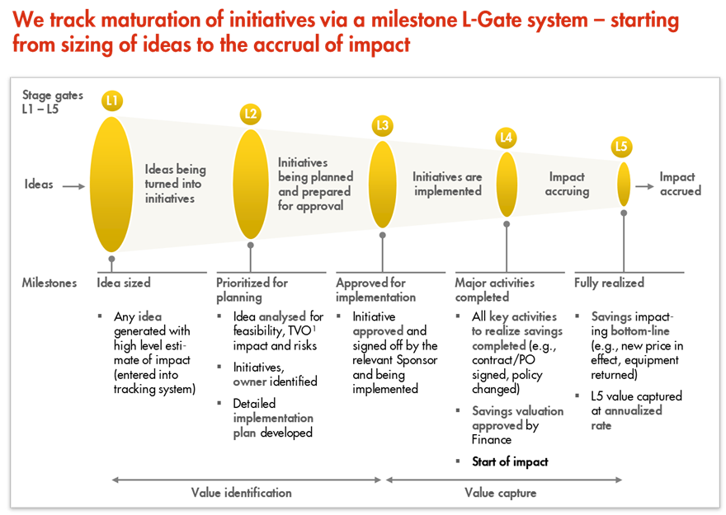
L1 – L5 Gates

